Slide 1
Intro to apis
Welcome!
With Serra canca
Before-Class 5 Minute Grace Time
TO-DO:
Write one fun / interesting thing you did over break in the chat!

Slide 2
About me
Grew up on Long Island, NY.
Was planning on getting a psychology degree, but switched to computer science after a few years.
Was an undergrad teaching assistant, and taught a remote CSCI136 section for a few semesters after graduating.
I’m also an associate software engineer. I work remotely and am part of a team that owns a few APIs and databases.

Slide 3
What you’ll be learning
What an API is
Why APIs are used
The history of APIs
The different types of APIs
How to Properly Call an API
API design basics
API security basics
Main differences between C++ and C#
.NET Framework basics
GitHub basics
Postman basics
How to make an HTTP API with .NET Framework and Entity Framework
… And more!

Slide 4
General guidelines
No attendance will be taken– I trust that you’ll be in class regularly!
I will be posting all lecture slides on BlackBoard at 11:59pm on the day after the lecture.
This means that you’ll need to be in class in order to get in-class activity instructions, as those are due at 11:45pm the day after the lecture!
Use the hand-raise feature to ask a question and I will get to you ASAP.

Slide 5
Grading and evaluation
Short In-Class Activities: 40%
In-class activities are due at 11:45pm on the day after class. You may miss two without your grade being affected.
If more than 15 minutes late, 15% will be taken off the grade of the activity, and an additional 15% will be taken off at 24 hours after the due date-time. If 48 hours+ late, you will not be allowed to hand in the activity.
Quizzes: 30%
The lowest quiz grade will dropped.
Final Project: 30%
Please let me know if you need any special accommodations!

Slide 6
The project
You will be making your very own API using the ASP.NET Core framework!
You won’t need to worry about making a front end (the graphical user interface– what a user would typically see and interact with.)
The ASP.NET Core framework uses C#. We’ll be going over some of the major differences between C++ and C# before we start our project, so no need to stress.
Because we’re not making a front end, we need a way to be able to test our API through our API endpoint (the point at which an API would connect with another entity.) We’re going to be using Postman to do this!
Postman is an application used as a tool that allows us to build, test, and modify our APIs.
The type of API we will be making is referred to as an HTTP API. We’ll be going over the different types of APIs that exist throughout the semester.

Slide 7
What is an API, anyway?
API stands for “Application Programming Interface.”
APIs are used by different applications and services to communicate with each other.
Let’s check out some examples…

Slide 8

Imagine you’re at a restaurant and order some food by interacting with the waiter. You have a few options here– you can order food, or drinks, or ask for your check…
The waiter shields you from all of the more complicated tasks that happen behind the scenes. In essence, they are the interface that stands between you and the services that a restaurant offers.
In theory, the waiter is the API of your restaurant. It manipulates or searches through data from a source (like a database!) and presents the appropriate information to you.

Slide 9
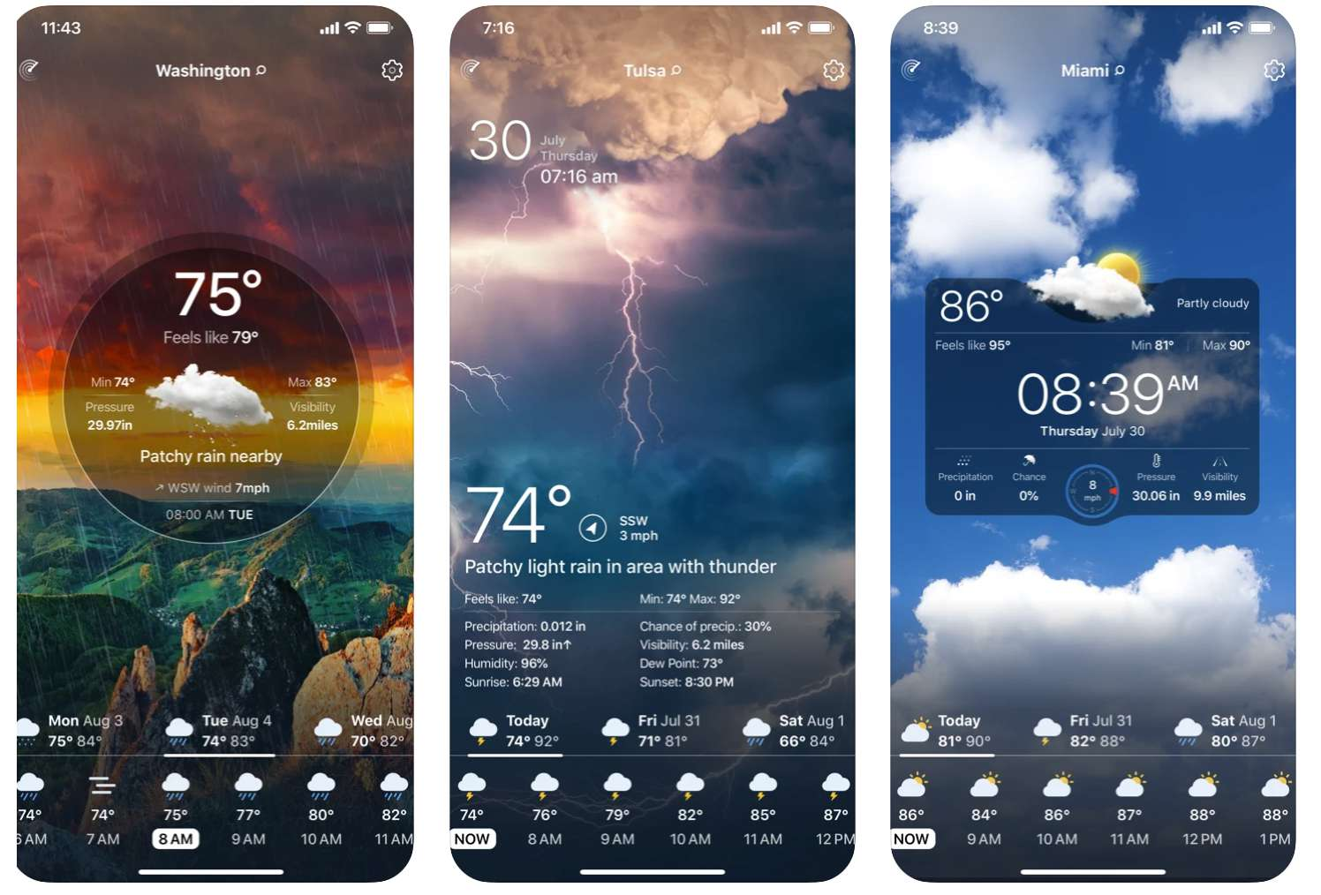
Consider a weather app. These typically use the API of a third party to gather information about the weather at different locations!
There are APIs that exist which give you information about videogames, books, music, and so much more. Consider the Google Books API– you can use this API to search for books via an author, title, genre, subgenre, etc.

Slide 10

Software company Mulesoft (they make a lot of integration software, which connects major pieces of software in order to prevent any isolated data) has put together a pretty good video on what an API is:

Slide 11
Mulesoft also had this to say about today’s APIs:
Over the years, what an “API” is has often been described as any sort of generic connectivity interface to an application. More recently, however, the modern API has taken on some characteristics that make them extraordinarily valuable and useful…
Modern APIs adhere to standards (typically HTTP and REST), that are developer-friendly, easily accessible and understood broadly.
They are treated more like products than code. They are designed for consumption by specific audiences (e.g., mobile developers), they are documented, and they are versioned in a way that users can have certain expectations of its maintenance and lifecycle.
Because they are much more standardized, they have a much stronger discipline for security and governance, as well as monitored and managed for performance and scale.
As any other piece of productized software, the modern API has its own software development lifecycle (SDLC) of designing, testing, building, managing, and versioning. Also, modern APIs are well-documented for consumption and versioning.
https://www.mulesoft.com/resources/api/what-is-an-api

Slide 12
Activity 1
Brainstorm and produce 3 solid ideas for an API one could call to manipulate (get, update, or delete) information from another source (and yes, you may use the weather app example)!
For each API, write down at least 3 different variables that the user could input in order to get the results they want. Use C# data types! A list of them can be found here:
https://www.tutorialsteacher.com/csharp/csharp-data-types
Example: Train Times API
1. DateAndTime - DateTime
2. FinalStopStationId - Int
3. ExpressOnly - Bool
* Remember, this is due at 11:45pm tomorrow!

Slide 13
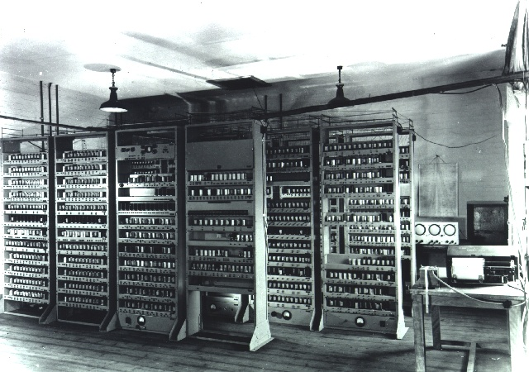
History of apis: 40s – 50s
David Wheeler and Maurice Wilkes, two computer scientists from England, had designed and helped build a software library for EDSAC– Electronic Delay Storage Automatic Calculator, which was an early British computer.
This archaic computer didn’t have an operating system and its CPU was made up of derated (meaning with power that is purposefully reduced) thermionic valves (vacuum tubes with electrodes in them).
An electrode is an electrical conductor used to make contact with a nonmetallic part of a circuit. An essential part of a battery.
The subroutines (program instructions) in this software library were stored on punched paper tape, organized in a filing cabinet. This catalog can be thought of as an archaic version of an API, because it instructs the programmer on how to use (call) each subroutine that it needs.
In 1951, Wheeler and Wilkes published the book titled In Preparation of Programs for an Electronic Digital Computer– it has in it the very first API specification. (SRS)*
* A software requirements specification (SRS) is a detailed description of a software system, generally one that is not developed yet, with its functional and non-functional requirements.

Slide 14
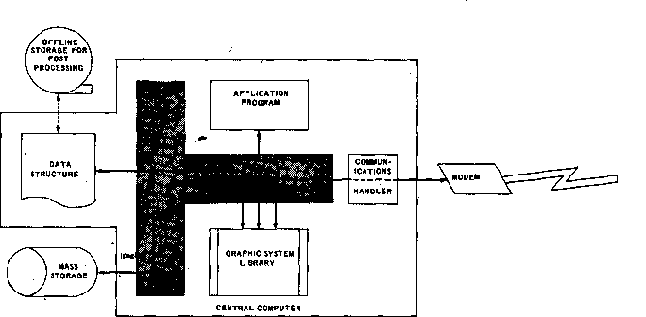
History of apis: 60s – 70s
The term “application program interface” (no –ing on program) was first seen during this time!
The term was written in a paper called “Data Structures for Remote Computer Graphics”, which was presented at a conference.
The authors of this paper, Ira W. Cotton and Frank S. Greatorex, understood the importance of APIs for developers and clients.
APIs weren’t invented so much as discovered. It is commonly argued that libraries (which consists of resources for the computer) naturally gave rise to APIs.

Slide 15
History of apis: 90s+
By 1990, the API was defined as “a set of services available to a programmer for performing certain tasks” by technologist Carl Malamud.
In the 90’s, remote procedure calls (a method of communication used to cause a procedure / subroutine to execute in a different address space via a computer program) and web APIs (internet-accessed APIs) start to appear!
As computer networks became more common, programmers wanted to call libraries located not only on their local computers, but also on computers located elsewhere.
In 2000, Roy Fielding, an American computer scientist, wrote a dissertation with the title “Architectural Styles and the Design of Network-based Software Architectures,” defining for the first time the representational state transfer (REST) architectural style, which emphasizes performance, scalability, simplicity, modifiability, and more. You could say he invented it! He described the idea of a “network-based application programming interface” (so, a network-based API).
Today, the web API is now the most common meaning of the term API.

Slide 16
Remote procedure calls? (Theory)
A remote procedure call is a software communication protocol (system of rules that allow two or more entities to communicate / transmit information) that one program can use to request a service from a different address space commonly located in another computer on a network (two or more computers that are linked in order to share resources), either by cable (wired) or WiFi (wireless).
Remote procedure calls are a form of inter-process communication, which is the mechanism provided by the operating system that allows processes to communicate with each other. This communication could involve a process letting another process know that some event had occurred, or the transferring of data from one process to another. Said processes may be running on one or more computers connected by a network.

Slide 17

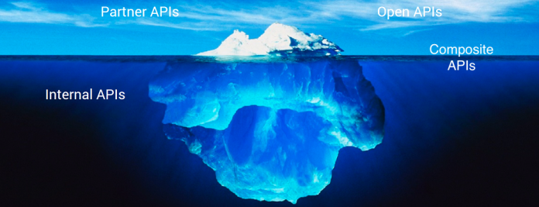
The 4 Different types of apis (privacy)
Open APIs – Publicly available to developers and other users with minimal restriction. They may require registration, use of an API key (a unique code that is passed to an API to identify the application or user that is trying to call it) or 0Auth (Open Authorization– a security framework used for token-based authorization on the internet), or may be completely open. They focus on external users, to access data or services.
Partner APIs – Exposed by/to strategic business partners. They are not available publicly, and a user / application would need specific entitlement to access them. While open APIs are available to all, partner APIs have an onboarding process with a specific validation workflow to gain access.

Slide 18
The 4 Different types of apis (privacy)
Internal APIs – Hidden from external users and only exposed to internal systems. Not meant for consumption outside of the company, but rather for use across different internal development teams for better productivity and reuse of services. (Remember DRY – Don’t Repeat Yourself!)
Composite APIs – Combine multiple APIs. Allow developers to access several endpoints in one call. (Remember, an endpoint is the point– typically a URL— at which an API would connect with another entity.) This type of API would be useful, for example, in an application that at any point must get information from several services to perform a task.

Slide 19

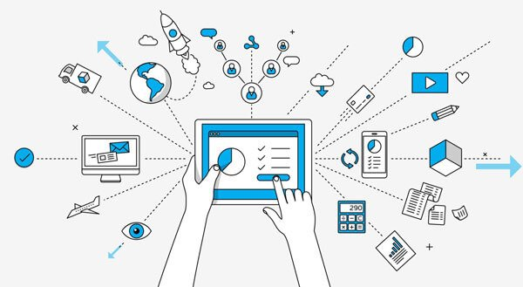
Web apis?
A Web API, as the name suggests, is an API that a client accesses through the internet. Web APIs use HTTP, which we will go over in the next slide. It is more of a concept than anything else, and includes many different types of APIs– including REST, SOAP, etc. (We’ll get more into these during our API design lecture!)

Slide 20
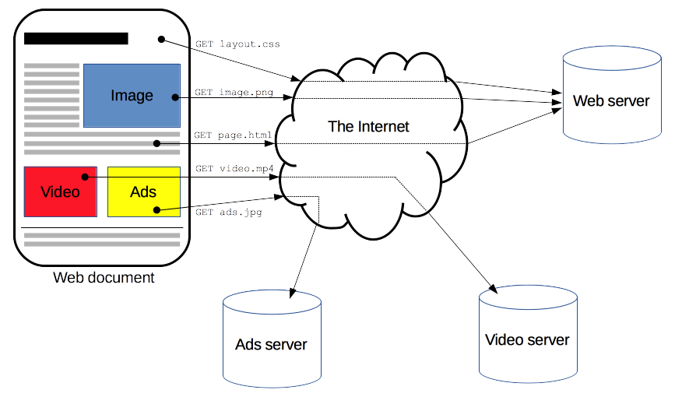
http
HTTP stands for HyperText Transfer Protocol. Is it a protocol (set of rules/procedures) for fetching resources.
HTTP is very commonly considered to be the foundation of any data exchange on the World Wide Web.
HTTP is a client-server protocol, which means requests are initiated by the recipient, (in our case, usually the web browser.)
A complete web document (web page) is usually reconstructed for a client from the different sub-documents fetched with HTTP commands-- for example; text, layout description, images, videos, and more.
Clients and servers communicate by exchanging individual messages (as opposed to a stream of data). The messages sent by the client, usually a web browser, are called requests (HTTP requests) and the messages sent by the server as an answer are called responses (HTTP responses).

Slide 21
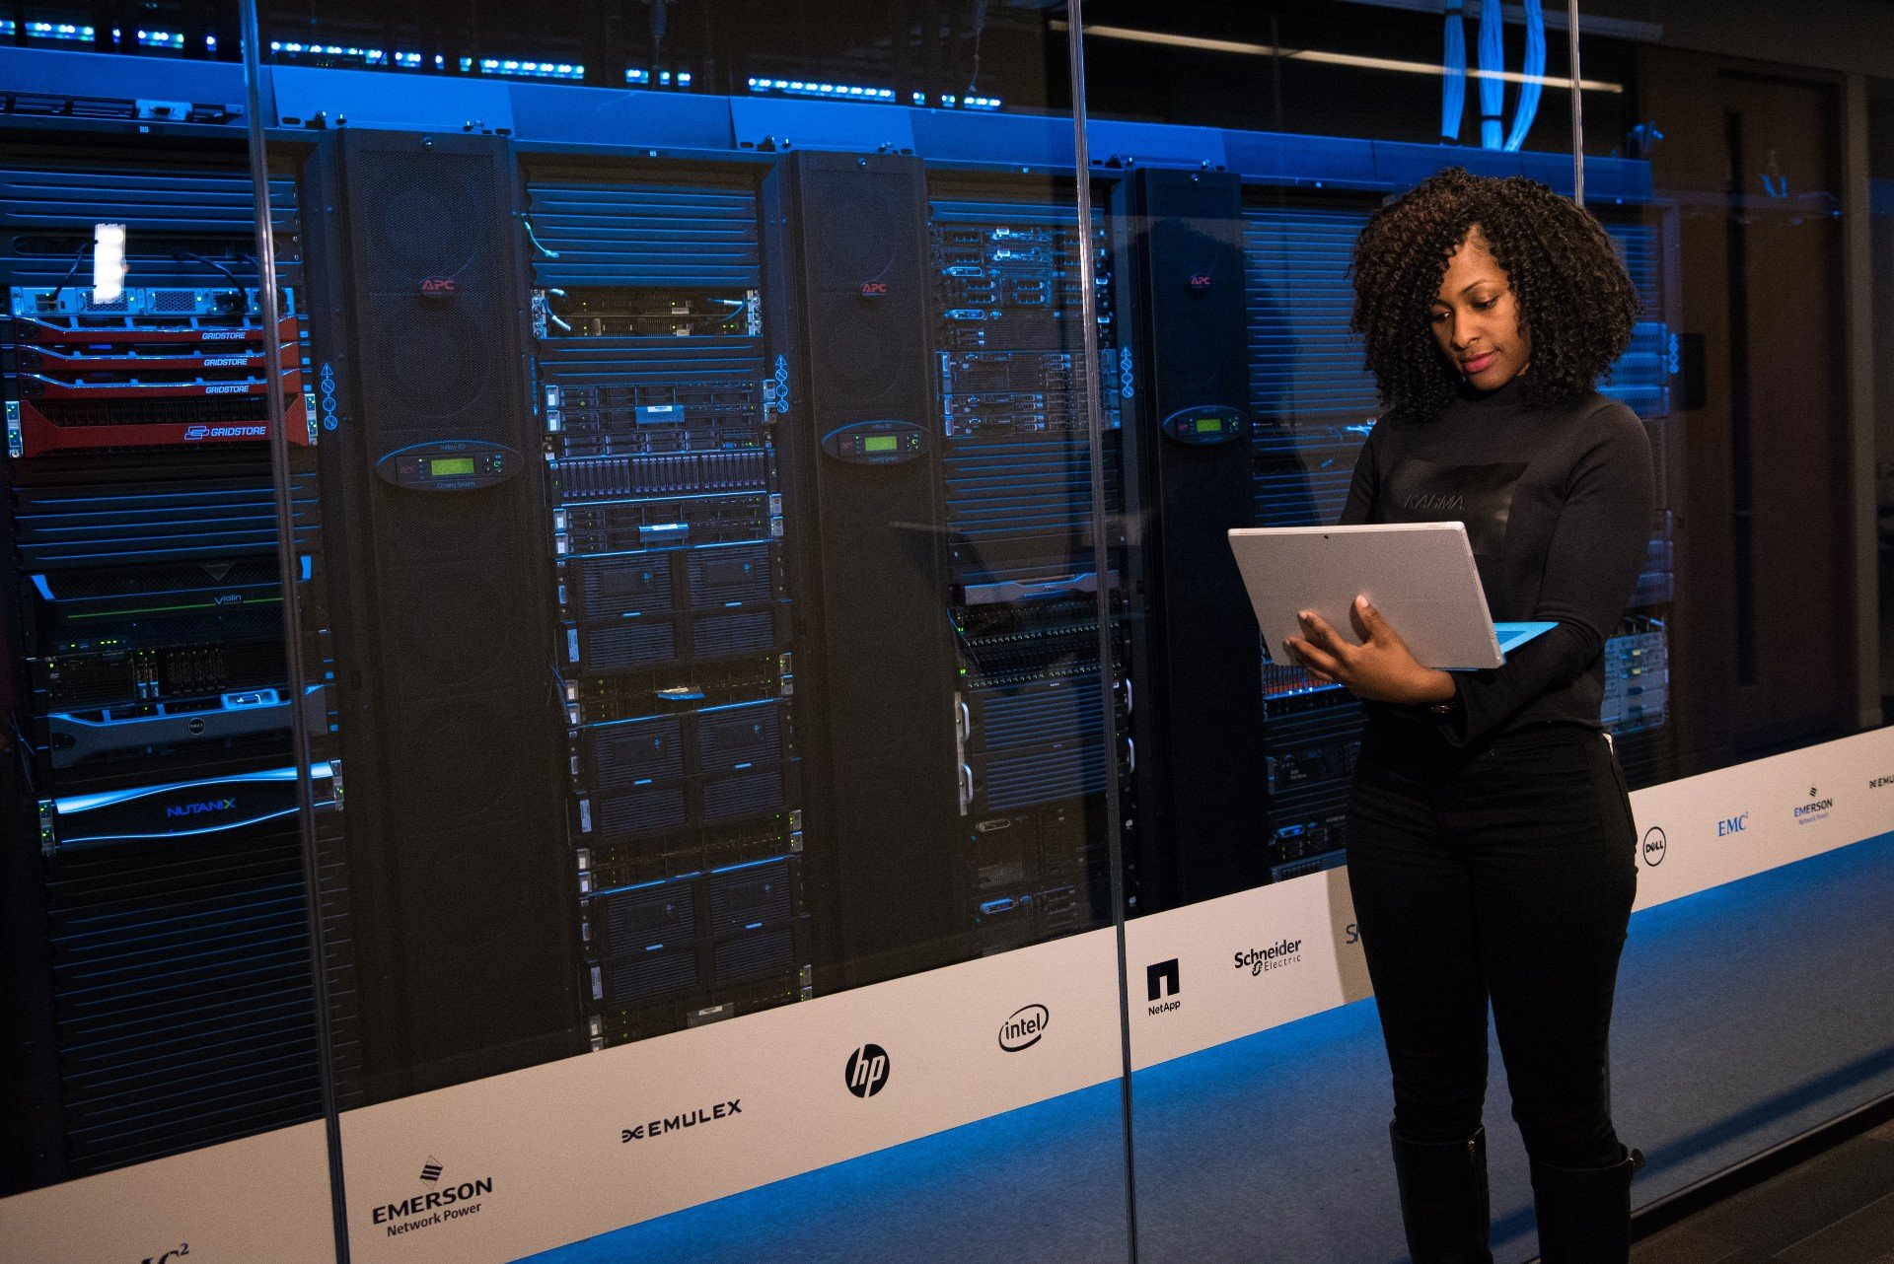
Servers
A server (also commonly referred to as a host) is a computer program or device that provides a service to another computer or device (called “client”, like in previously-discussed client-server protocol / model). In short, they are computers that run services to serve the needs of other computers.
A single server can serve multiple clients, and a single client can use multiple servers.
A client process may run on the same device as the server, or may connect to the server over a network if it is on another device.
A server stores, sends, and receives data. These are considered the three main functions of a server.
Commonly-seen types of servers are web servers, print servers, e-mail servers, database servers… the list goes on!

Slide 22
Servers
What would, for example, a 2022 massively multiplayer online game (MMO) server do?
The server would transmit enough data about its internal state to allow its connected clients (the players) to maintain their own accurate version of the game world (via their machines’ screen, typically!)
The server would also receive and process each player’s input.

Slide 23
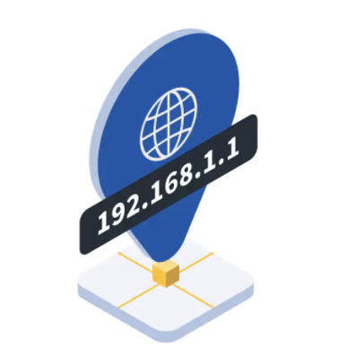
Internet protocol (IP) addresses
An IP address is a unique address that identifies a device on the internet or a local network. IP stands for "Internet Protocol," which is the set of rules governing the format of data sent via the internet or local network.
IP addresses are the identifier that allows information to be sent between devices on a network; they contain location information and make devices accessible for communication. The internet needs a way to differentiate between different computers, routers, and websites. IP addresses provide a way of doing so.
IP addresses are expressed as a set of four numbers separated by periods– an example address might be 192.158.1.38. Each number in the set can range from 0 to 255. So, the full IP addressing range goes from 0.0.0.0 to 255.255.255.255.
IP addresses are not random. They are mathematically produced and allocated by the Internet Assigned Numbers Authority (IANA), a division of the Internet Corporation for Assigned Names and Numbers (ICANN). ICANN is a non-profit organization that was established in the United States in 1998 to help maintain the security of the internet and allow it to be usable by all.

Slide 24
Internet protocol (IP) addresses
Every individual or business with an internet service plan has two types of IP addresses: their private IP addresses and their public IP address.
A public IP address can be accessed directly over the internet and is assigned to your network router by your internet service provider (ISP). Your personal device also has a private IP that remains hidden when you connect to the internet through your router’s public IP.
The terms public IP address and external IP address are essentially interchangeable. No matter which phrasing you prefer, the function is the same: a public (or external) IP address helps you connect to the wider internet.
Public IP addresses can be traced back to your ISP, which can potentially reveal your general geographical location. When advertisers, governments, or hackers know where you’re connecting from, it’s easier for them to follow what you do online.
Websites also use IP tracking to analyze online behavior patterns, making it easier for them to determine if the same individual visits the site repeatedly. Websites can then use these patterns to predict your preferences!

Slide 25
Internet protocol (IP) addresses
Every device that connects to your internet network has a private IP address. This includes computers, smartphones, and tablets but also any Bluetooth-enabled devices like speakers, printers, or smart TVs. Your router needs a way to identify these items separately, and many items need a way to recognize each other. Therefore, your router (device that communicates between the internet and the devices in your home that connect to the internet) generates private IP addresses that are unique identifiers for each device that differentiate them on the network.
Private IP addresses let devices connected to the same network communicate with one another without connecting to the wider internet. By making it more difficult for an external host or user to establish a connection, private IPs help bolster security within a specific network, like in your home or office. This is why you can print documents via wireless connection to your printer at home, but your neighbor can’t send their files to your printer accidentally... Usually.
Private IP address and internal IP address are interchangeable terms. A private IP address is also often called a local IP address.

Slide 26
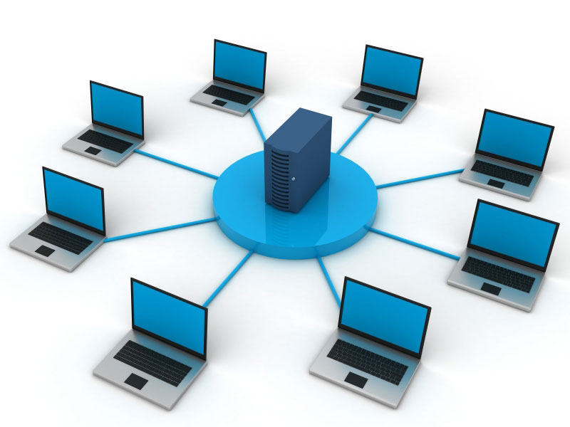
Types of networks
Personal Area Network (PAN): This is the smallest and most basic network that you’ll find. It’s meant to cover a very small area (typically a single room or building). A PAN is most commonly used for one individual and to connect just a handful of devices such as a computer, smart phone, and printer. Probably the most well-known PAN technology is Bluetooth connection. So, next time you connect your phone to your car to play music, you can thank your Personal Area Network!
Local Area Network (LAN): This is an extremely common and well-known type of network. Just as the name suggests, a LAN connects a group of computers or devices together across a local area. This type of network can be utilized to connect devices throughout one building or even 2-3 buildings depending on the proximity to each other. Whether your office location utilizes wired or wireless connection, it’s almost surely using a LAN connection. This brings us to the next type of network…
Wireless Local Area Network (WLAN): A WLAN is simply a LAN that does not rely on cables to connect to the network. So, when you’re using WiFi, you’re using a WLAN. WLANs are typically used in the same scenario as LANs, it just depends on whether you’d prefer an on premises or remote cloud solution (wires or wireless).

Slide 27
Types of networks
Metropolitan Area Network (MAN): Larger than a LAN but smaller than a WAN, a MAN incorporates elements of both types of networks. It connects multiple LANs together and spans an entire geographical area such as a city or town (or sometimes a campus). Ownership and management can be handled by a single person, but it’s more likely done by a larger company or organization.
Wide Area Network (WAN): Like LANs, you very well may recognize the term “WAN.” WANs do the same thing as LANs but across a larger area while connecting more devices. Even when miles apart, a WAN can connect devices together remotely. In fact, the most basic example of a WAN is the Internet which connects computers and devices worldwide. Since it’s much larger, this type of network is typically maintained by multiple administrators and ownership is distributed across various organizations.
Storage Area Network (SAN): A SAN is another type of LAN that’s designed to handle large data transfers and storage. This purpose of this network is to move larger, more complex storage resources away from the network into a separate, high-performance atmosphere. Doing this not only allows for easy retrieval and storage of the data but it also frees up space and improves overall performance of the original network.
Virtual Private Network (VPN): The point of a VPN is to increase security and privacy while accessing a network. The VPN acts as a middleman between you and the network by encrypting your data and hiding your identity. This is a great option for sending and receiving sensitive information, however, using a VPN is ideal anytime you connect to the Internet. Anytime you’re on a public network, you run the risk of being targeted by a hacker, so using a VPN is you best bet at ensuring your cybersecurity.

Slide 28
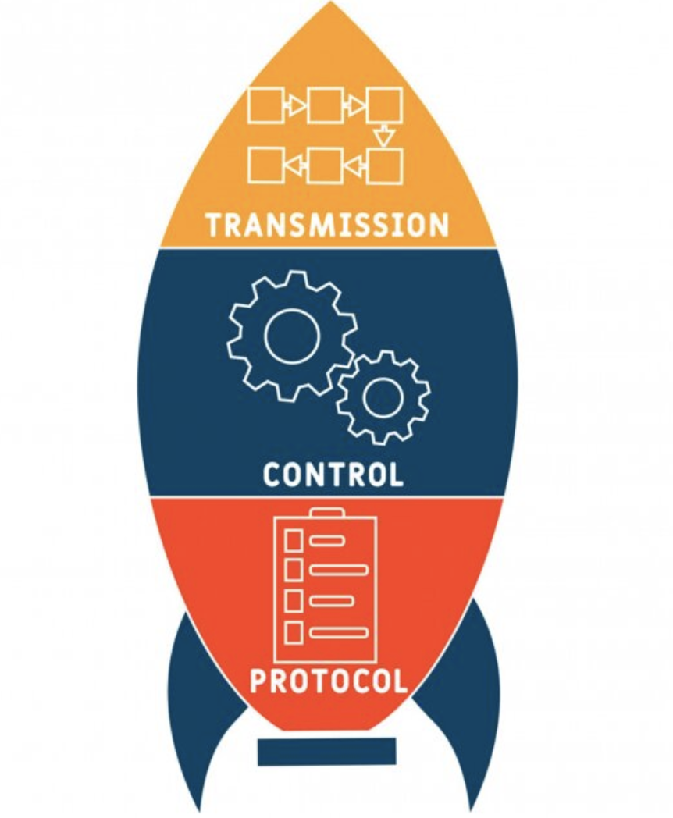
Transmission Control Protocol (TCP)
Transmission Control Protocol (TCP) is a connection-oriented communications protocol that enables/facilitates the exchange of messages between computing devices in a network. It is the most common protocol in networks that use the Internet Protocol (IP).
TCP takes messages from an application/server and divides them into packets (a small segment of a larger message), which can then be forwarded by the devices in the network (such as switches, routers, security gateways) to the appropriate destination(s).
Because it is connection-oriented, it ensures a connection is established and maintained until the exchange between the application/servers sending and receiving the message is complete.
Almost all data that moves across the internet does so via TCP– HTTP, SSH, and many more popular protocols use TCP.
When HTTP wants to transmit a message, it streams the contents of the message data, in order, through an open TCP connection. HTTP uses TCP because it's important that the client receives all of the data sent by the server.

Slide 29
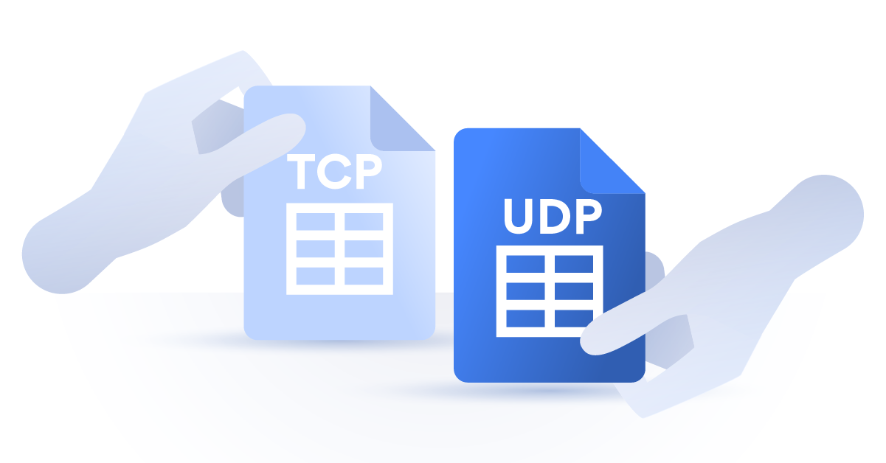
User Datagram Protocol (UDP)
User Datagram Protocol (UDP) is a protocol that, much like TCP, transmits data in packets, but…
It is not connection-oriented. Unlike TCP, this protocol does not establish a session (temporary and interactive information interchange) before it enables communication between the two computers/machines.
A datagram is an independent, self-contained (meaning that it is a complete representation of a specific event) message sent over the network whose arrival, arrival time, and content are not guaranteed.
We used the term packet when it comes to what TCP creates and utilizes. Remember, TCP is connection-oriented. “Datagram” is a synonym for packets when using UDP; it is connection-less. Datagrams don’t care about whether data is reached to its destination or not, or whether any error occurred while transmission– it does not retain that information.
Usually implemented in cases where a constant data stream is not really needed.

Slide 30
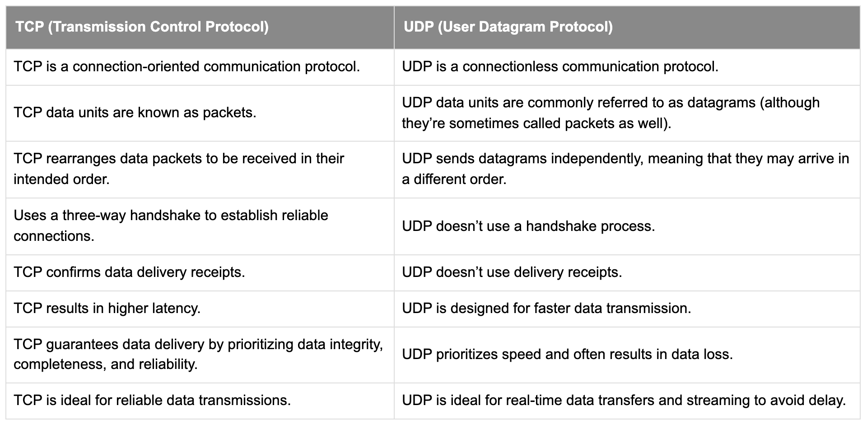
Transmission control protocol (TCP) vs. User datagram protocol (udp)

Slide 31
URLs
URL stands for Uniform Resource Locator. A URL is nothing more than the address of a given unique resource on the World Wide Web. In theory, each valid URL points to a unique resource. Such resources can be an HTML page, a CSS document, an image, etc.
A URL is composed of different parts, some mandatory and others optional.
Scheme: Indicates the protocol that the browser must use to request the resource.
Domain Name: Indicates which web server is being requested. An IP address may also be used here (but this is rare as it is much less convenient).
Port: Indicates the technical "gate" used to access the resources on the web server. It is usually omitted if the web server uses the standard ports of the HTTP protocol (80 for HTTP and 443 for HTTPS) to grant access to its resources. Otherwise, it is mandatory.
Path to the file: The path to the desired resource on the web server. In the early days of the web, a path like this represented a physical file location on the web server. Nowadays, it is mostly an abstraction handled by web servers without any physical reality.

Slide 32
URLs
Parameters: Extra parameters provided to the web server. A list of key/value pairs separated with the & symbol. Added towards or at the end of a URL after a ‘?’ symbol, and multiple parameters can be included when separated by the ‘&’ symbol. There are a number of reasons to use URL parameters. The most common are sorting and filtering, pagination, searching, language selection / translation (/home?lang=fr), and so on.
Anchor: Represents a sort of "bookmark" inside the resource, giving the browser the directions to show the content located at that "bookmarked" spot. On an HTML document, for example, the browser will scroll to the point where the anchor is defined; on a video or audio document, the browser will try to go to the time the anchor represents.

Slide 33
URIs
URI stands for Uniform Resource Identifier.
The terms “URI” and “URL” are often used interchangeably, but they are not exactly the same. A URI is an identifier of a specific resource. A URL is a type of URI.
A URI is a unique character sequence that identifies a specific resource– like a book, or a page, or a document.
For example, foo://example.com:8042/over/there?name=ferret#nose is a URI containing a scheme name, authority, path, query and fragment. A URI does not need to contain all these components. All it needs is a scheme name and a file path, which can be empty.
Here’s another example of a URI: telnet://192.0.2.16:80/. In this example, “telnet” is the scheme name and the numbers after the double slash make up the authority. The path is empty, which is why no characters come after the slash

Slide 34
URNs
URN (Uniform Resource Name) describes a name that identifies a resource on the Internet. Unlike URLs, which use network addresses (domain, directory path, file name), URNs use regular words that are protocol (like http) and location (like myDomain/MyDirectory/MyFile.cs) independent. Both URNs (names) and URLs (locators) are URIs, and a particular URI may be both a name and a locator at the same time.
A URN is similar to a person's name, while a URL is like a street address. The URN defines something's identity, while the URL provides a location. Essentially URN vs. URL is "what" vs. "where". A URN has to be of this form: <URN> ::= "urn:" <NID> ":" <NSS>
NID represents the namespace identifier, which should be registered in IANA (The Internet Assigned Numbers Authority). IANA regulates and monitors the domain names, IP addresses, and protocol parameter identifiers that are used by Internet standards.
NSS identifies the specific resource.

Slide 35
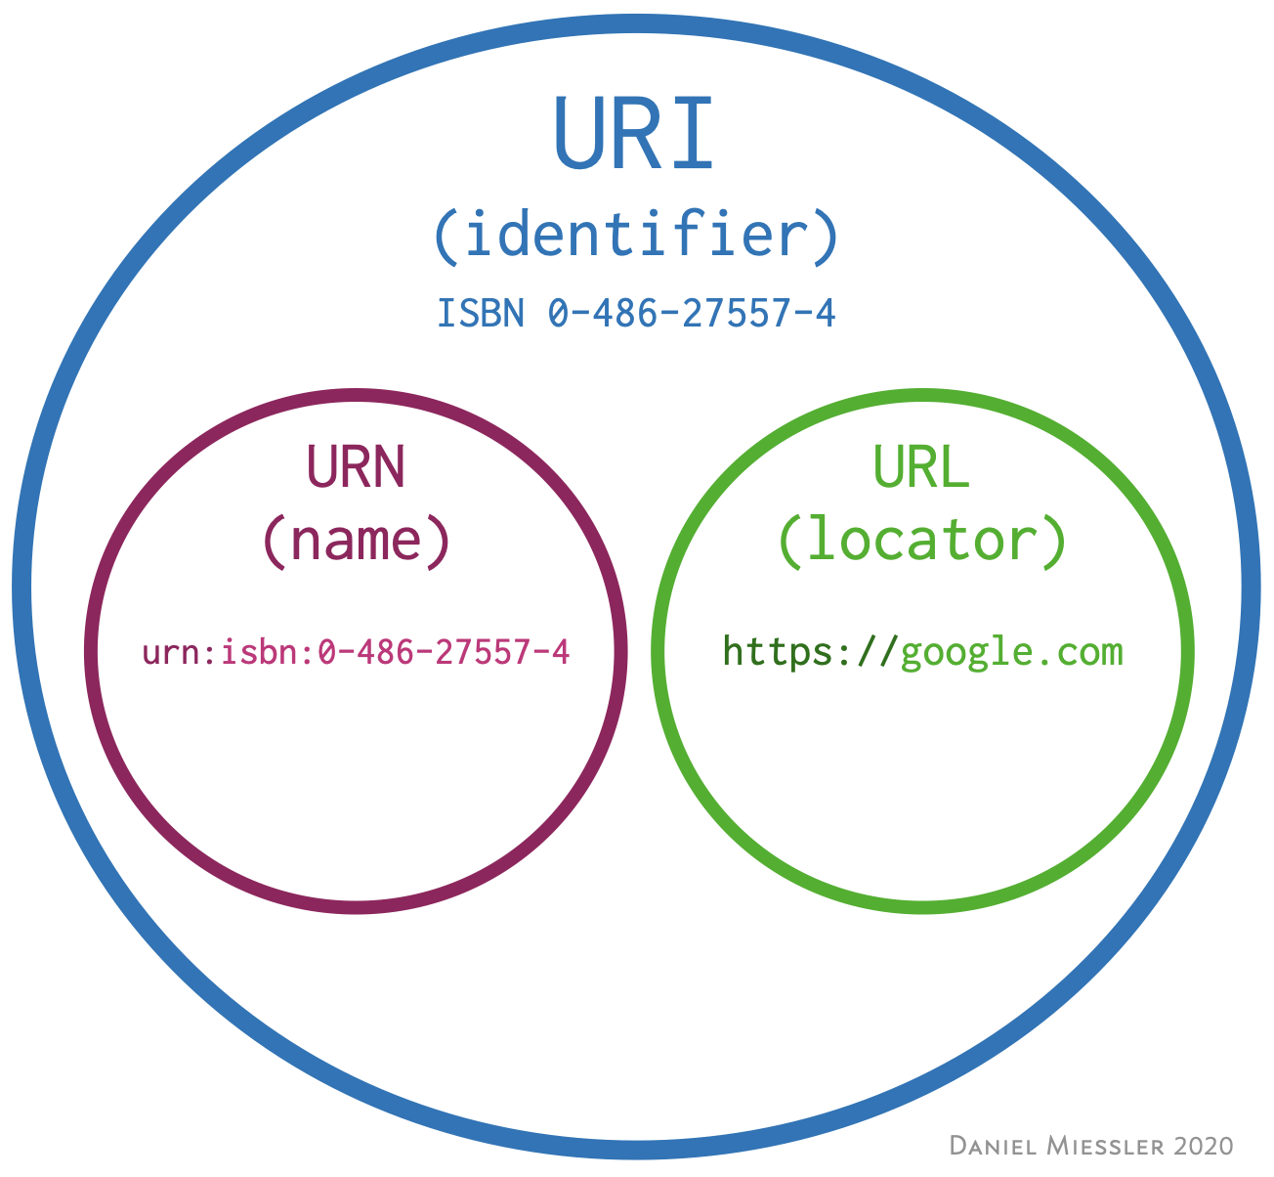

Slide 36
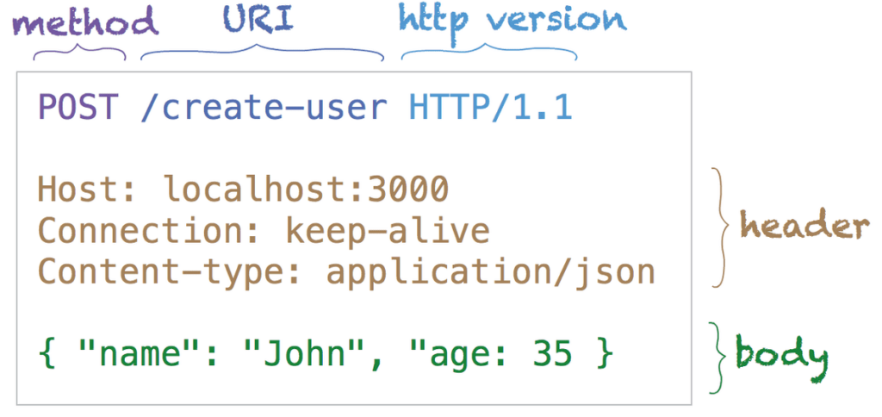
http requests
As we now know, an HTTP request is made by a client to a server. To make the request, the client uses components of a URL. HTTP requests contain the following elements:
An HTTP method (usually a verb like GET, POST, or a noun like OPTIONS or HEAD) that defines the operation the client wants to perform. Typically, a client wants to fetch a resource (using GET) or send data (using POST).
The path of the resource to fetch; the URL or URI of the resource stripped from elements that are obvious from the context, for example without the protocol, or the TCP port.
Optional headers that convey additional information for the servers.
A body, used for some methods like POST where data is being sent.

Slide 37
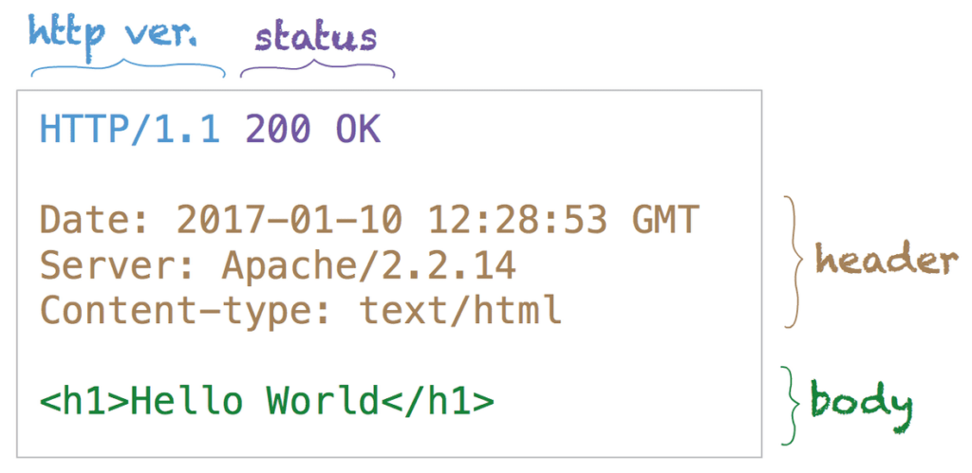
http responses
An HTTP response is made by a server to a client. The aim of the response is to provide the client with the resource it requested and/or inform the client that the action it requested has been carried out; otherwise, it is used to inform the client that an error has occurred in processing its request. An HTTP response contains:
The status of a request.
A series of HTTP headers, or header fields.
A message body, which is usually needed.

Slide 38
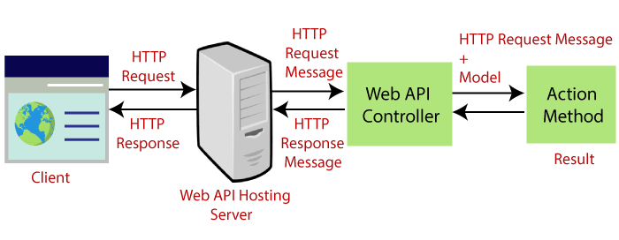

Slide 39
http methods
GET – Used to request data.
POST – Used to send data.
PUT – Used to send data– the difference between PUT and POST is that PUT can not create duplicates– in contrast, calling a POST request repeatedly can potentially create the same record multiple times, depending on how things in the API in question are set up.
HEAD – Used to ask for a response identical to that of a GET request, but without the response body. For example, if a URL might produce a large download, a HEAD request could read its content-length header to check the files size without actually downloading the file.

Slide 40
http methods
PATCH – Used to send partial data that is to be updated without modifying the entire record.
DELETE – Used to delete a specified record.
OPTIONS – Used to get information describing communication options for the target resource (like an API endpoint.)
TRACE – Used to perform a message loop-back test along the path to the target resource, providing to the client a useful debugging mechanism.
CONNECT – Used to create an HTTP tunnel through a proxy server (a computer that acts as a gateway between a local network– like all the computers at one company or in one building– and a larger-scale network, such as the internet). By sending this request, the client asks the proxy server to forward the TCP connection to the desired destination.

Slide 41
http response codes
1xxs – Informational responses: The server is thinking through the request.
Example: 100 – Continue
2xxs – Success! The request was successfully completed and the server gave the browser the expected response.
Example: 200 – OK
3xxs – Redirection: You got redirected somewhere else. The request was received, but there’s a redirect of some kind.
Example: 301 – Permanent Redirect
4xxs – Client errors: Page not found. The site or page couldn’t be reached. (The request was made, but the page isn’t valid — this is an error on the website’s side of the conversation and often appears when a page doesn’t exist on the site.)
Example: 404 – Not Found
5xxs – Server errors: Failure. A valid request was made by the client but the server failed to complete the request.
Example: 500 – Internal Server Error

Slide 42
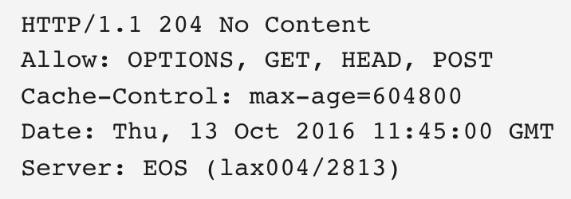
Example of an http response for an options request

Slide 43

Ssh protocol
SSH stands for Secure Shell. SSH protocol is a network communication protocol that enables two computers to communicate and share data. It utilizes a form of client-server protocol in which clients and servers communicate via a secure channel. SSH is often used to "log in" and perform operations on remote computers but it may also be used for transferring data.

Slide 44
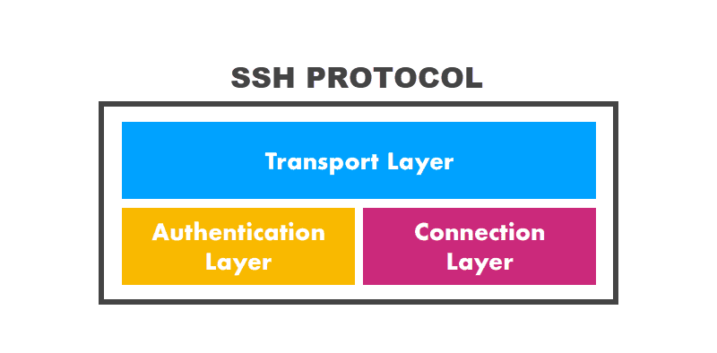
Ssh protocol - layers
The SSH protocol has three layers:
The Transport Layer: Ensures secure communication between the server and the client, monitors data encryption/decryption, and protects the integrity of the connection. Also performs data caching and compression..
The Authentication Layer: Conducts the client authentication procedure.
The Connection Layer: Manages communication channels after the authentication.

